Slide 1

Rideshare regression
Elliot Tam

Slide 2


Changes in san Francisco (2010-2016)
In 2010, Transportation Network Companies(TNC) were first allowed into San Francisco, growing rapidly over the past decade - est. 62 million rides in 2016
TNCs were responsible for 51% of the increase in traffic during this period
70,000 new residents and over 150,000 new jobs
Source: https://www.sfcta.org/sites/default/files/2019-05/TNCs_Congestion_Report_181015_Finals.pdf
Notes:
For comparison, the total number TNC rides worldwide just two years prior was 190 million.

Slide 3

The commute challenge
While San Francisco continues to grow in population, the space for vehicles does so minimally in proportion
The current TNC level of activity poses problems with traffic, carbon emissions, equity, and quality of life in the city
For public transportation to be a viable alternative, improvements in service need to be made
Notes:
WHILE RIDESHARES PROVIDE BENEFITS
– either in new routes or frequency

Slide 4
PROJECT objective
Create a model to evaluate which street sections are most frequently utilized by TNCs to support decisions making in public transportation route creation and frequency.
Notes:
ADD BUS TO CAR RATIO
PUBLIC TRANSPORTATION = NO PARKING, BETTER FOR ENVIRONMENT, AND CHEAPER

Slide 5
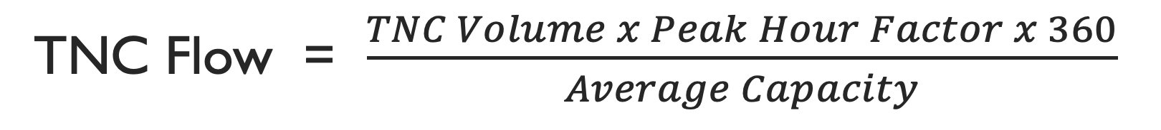
TARGET variable
TNC Flow = $\frac{TNC Volume x Peak Hour Factor x 360}{Average Capacity}$

Slide 6
TARGET variable
Total rideshares that run through area
TNC Flow = $\frac{TNC Volume x Peak Hour Factor x 360}{Average Capacity}$

Slide 7
TARGET variable
Share of the total period volume that occurs in the highest 1-hour period
TNC Flow = $\frac{TNC Volume x Peak Hour Factor x 360}{Average Capacity}$

Slide 8
TARGET variable
Scalar based on information given about dataset
TNC Flow = $\frac{TNC Volume x Peak Hour Factor x 360}{Average Capacity}$

Slide 9
TARGET variable
TNC Flow = $\frac{TNC Volume x Peak Hour Factor x 360}{Average Capacity}$
Capacity per hour for a given street section

Slide 10
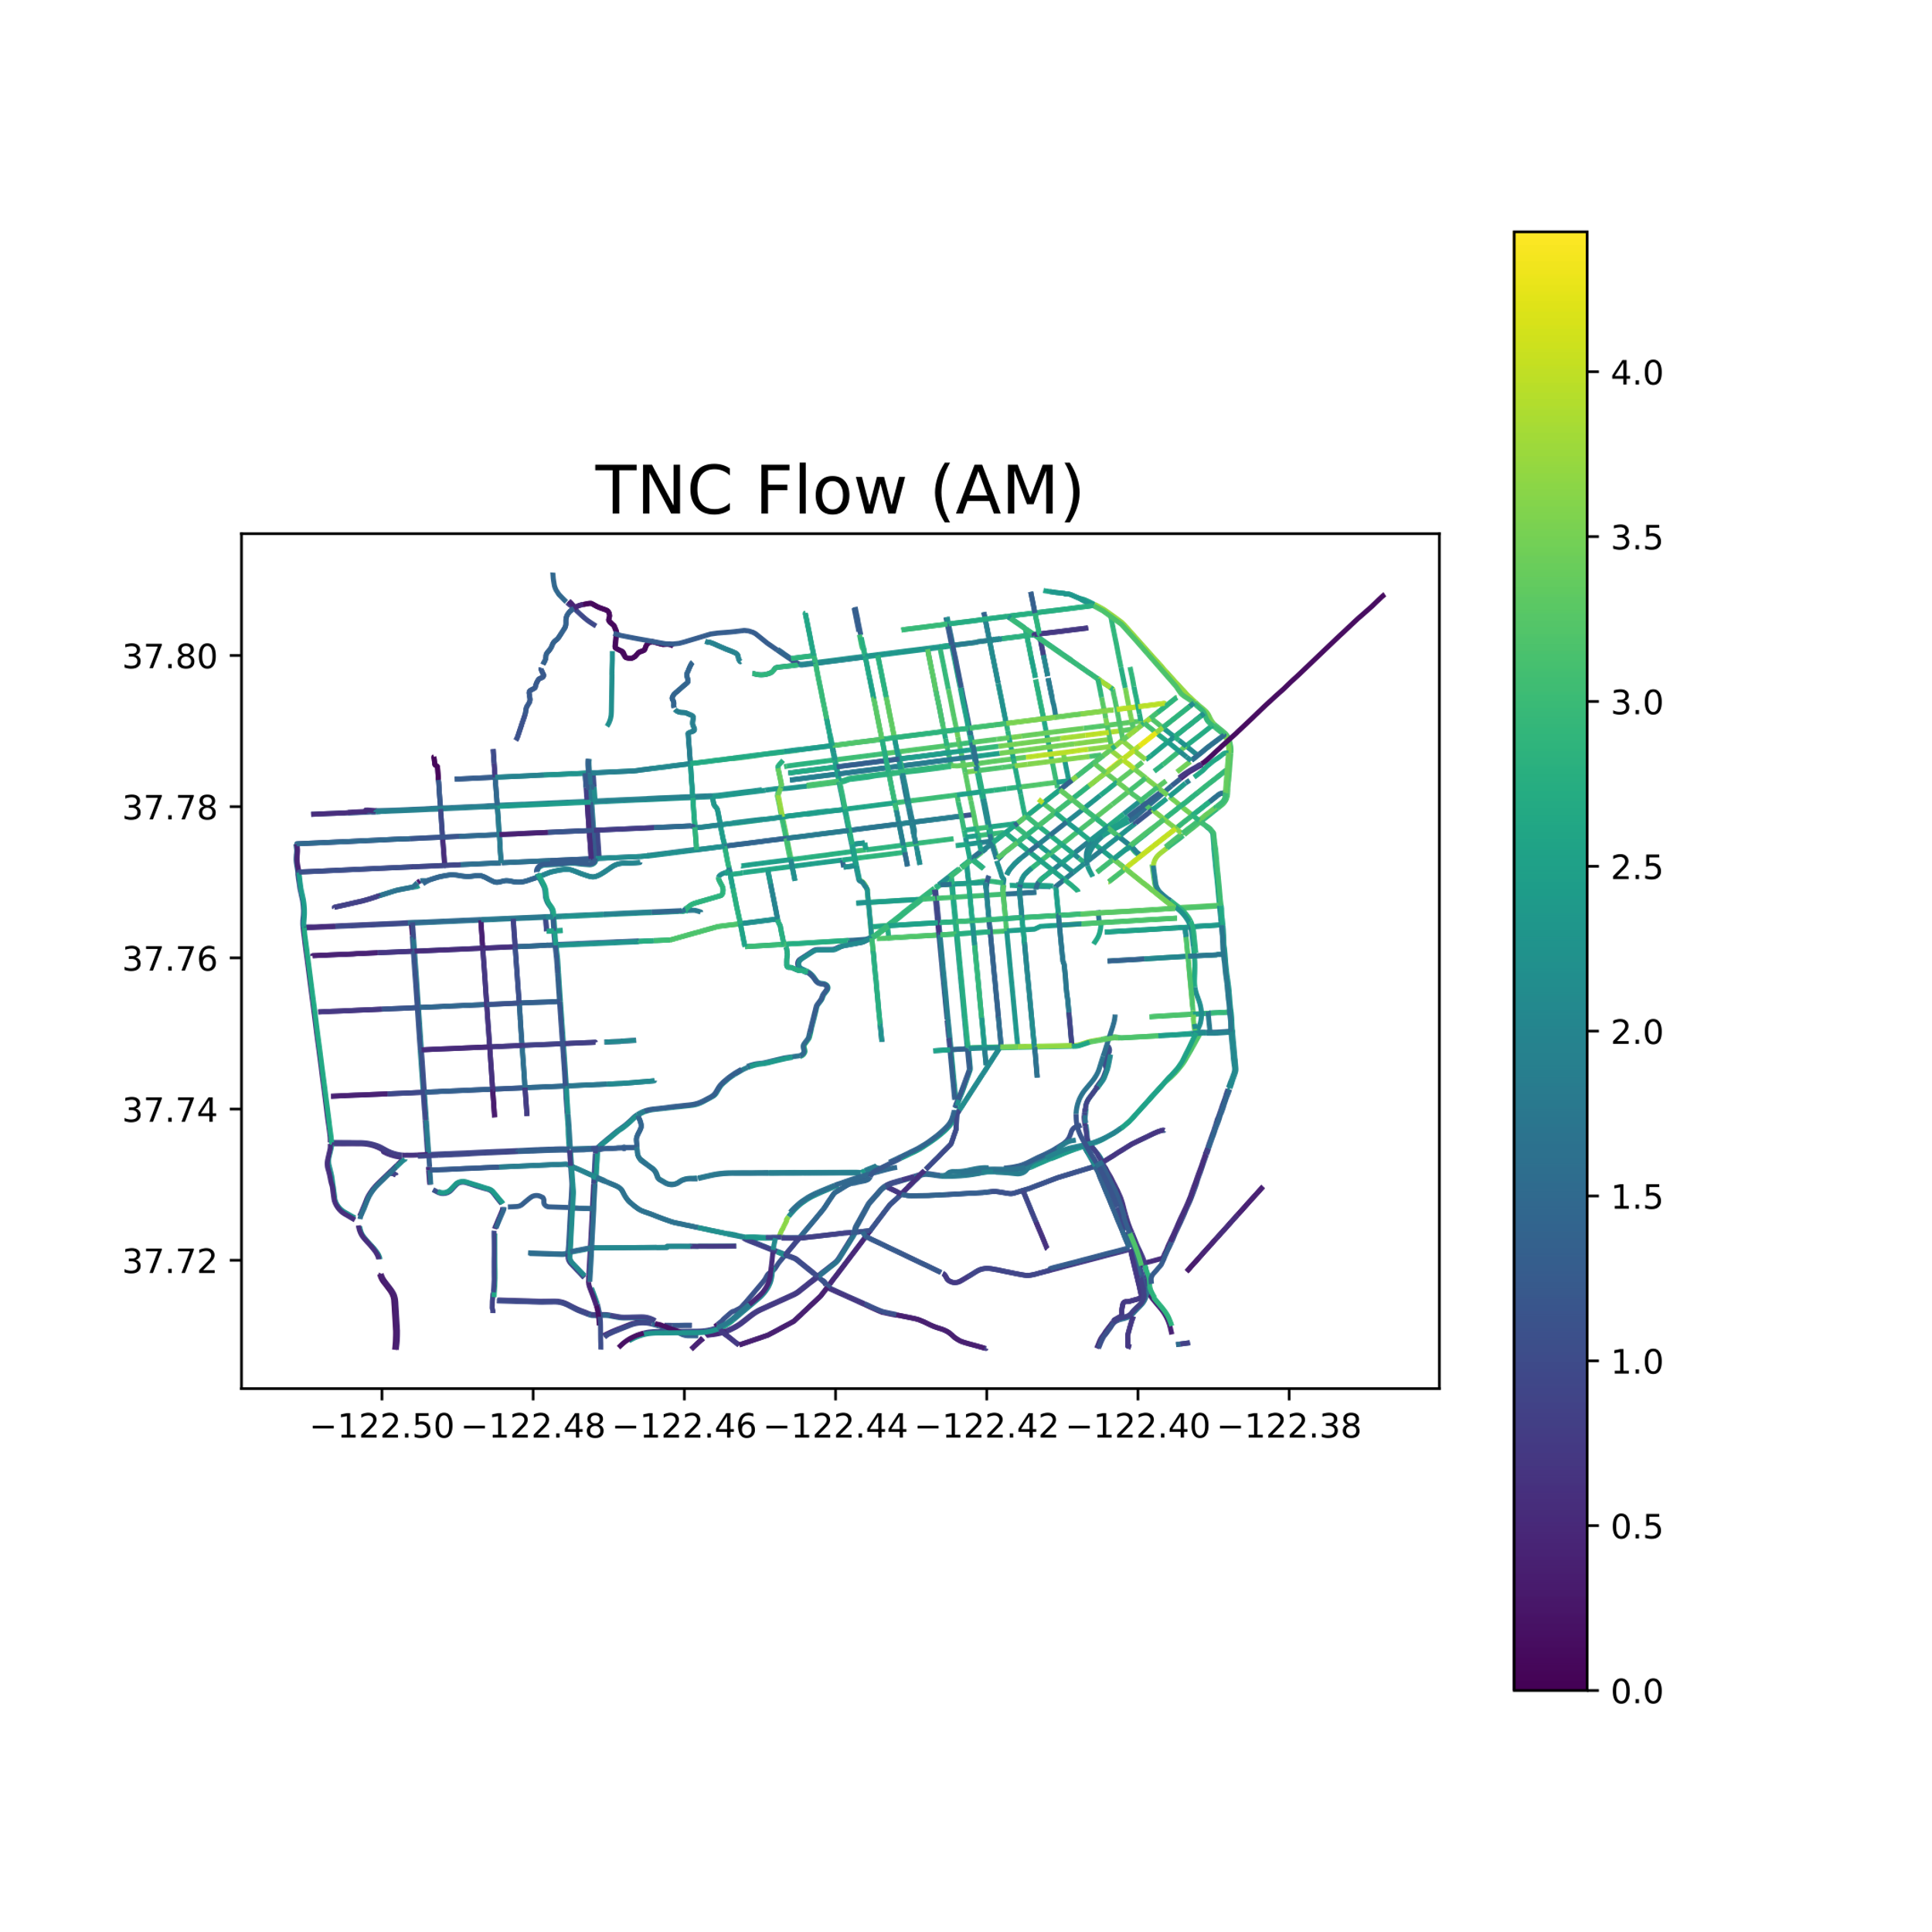

Tnc flow San Francisco

Slide 11



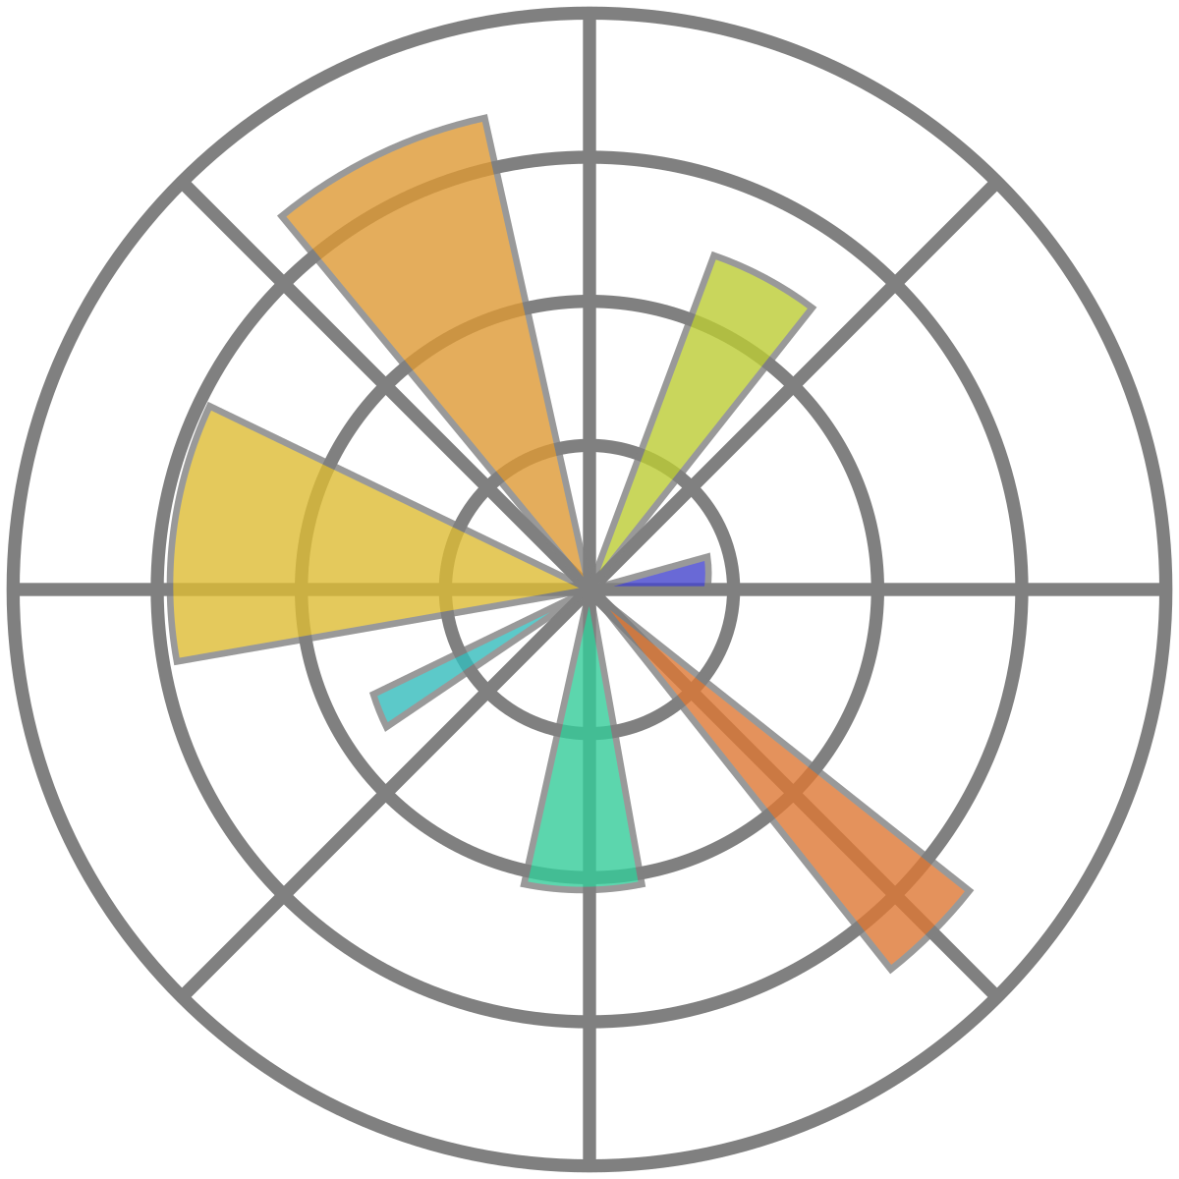



PROCESS
DATA
MODELS
VISUALS

Slide 12
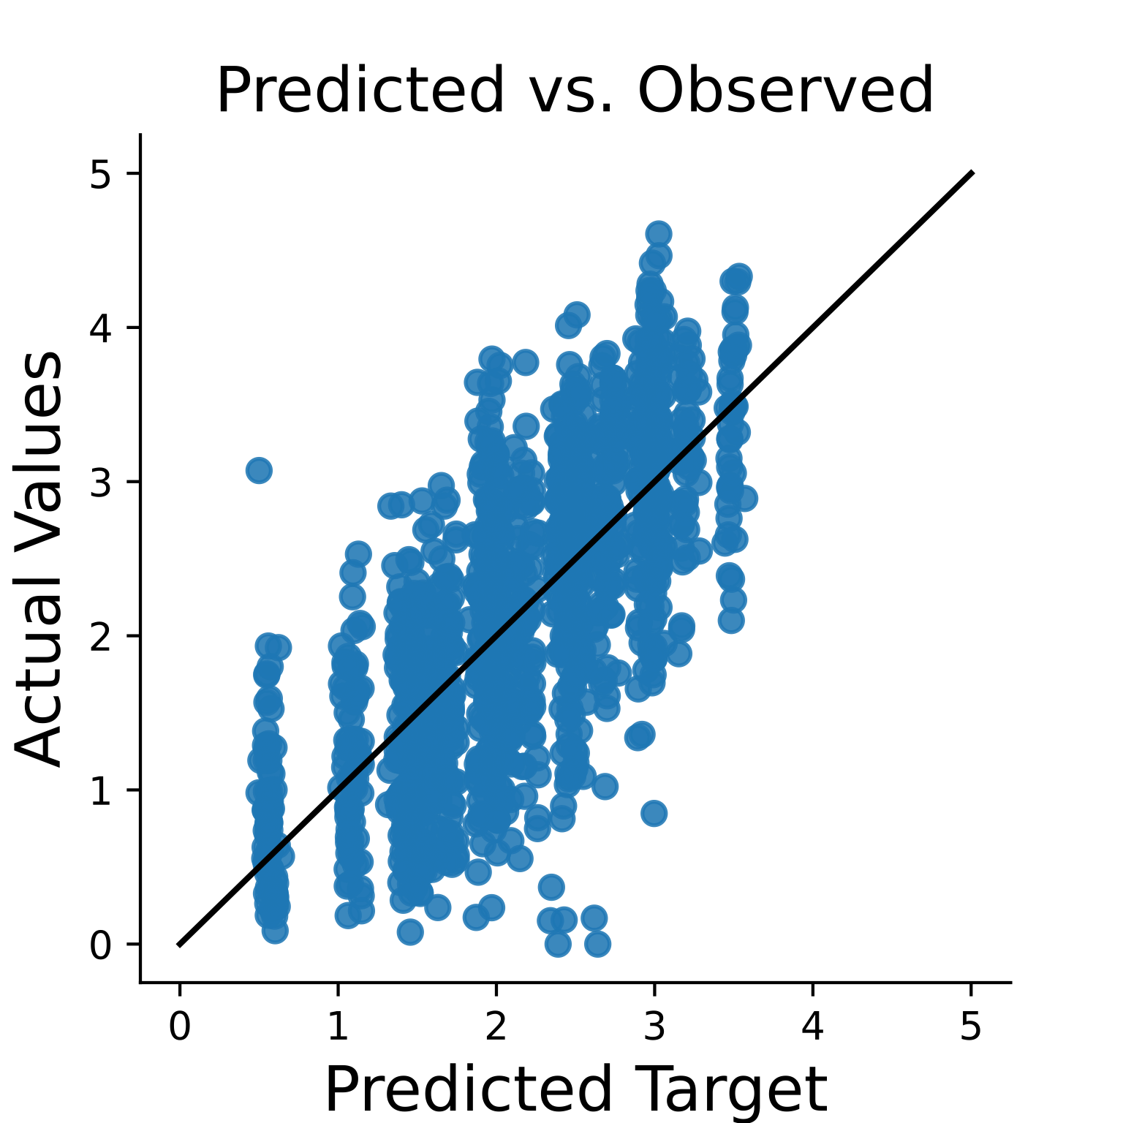
MODELING results
TNC Flow
With given variables, our model effectively explains ~53% of variance in TNC Flow (Adjusted R²: 0.5285)
Our model averages an inaccuracy of 0.52 per prediction MAE: 0.5209
TNC Flow

Slide 13

MODELING results
Consistent variance of errors through predictions
TNC Flow
With given variables, our model effectively explains ~53% of variance in TNC Flow (Adjusted R²: 0.5285)
Our model averages an inaccuracy of 0.52 per prediction MAE: 0.5209
TNC Flow

Slide 14
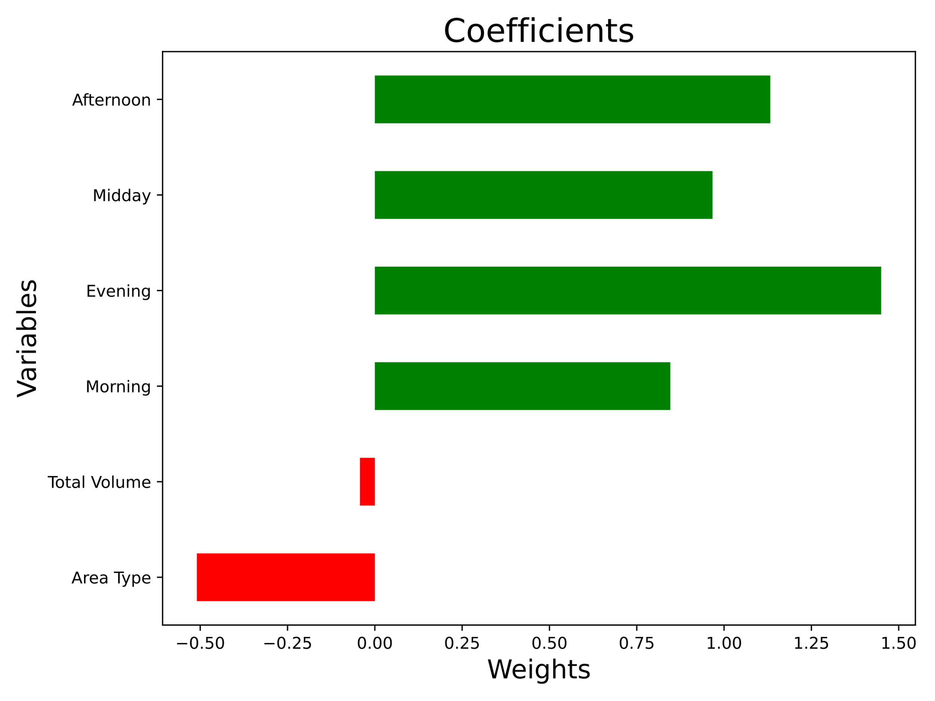
COEFFICIENTS

Slide 15
COEFFICIENTS
Comparing times of day, TNC flow is elevated during the afternoon and evening

Slide 16
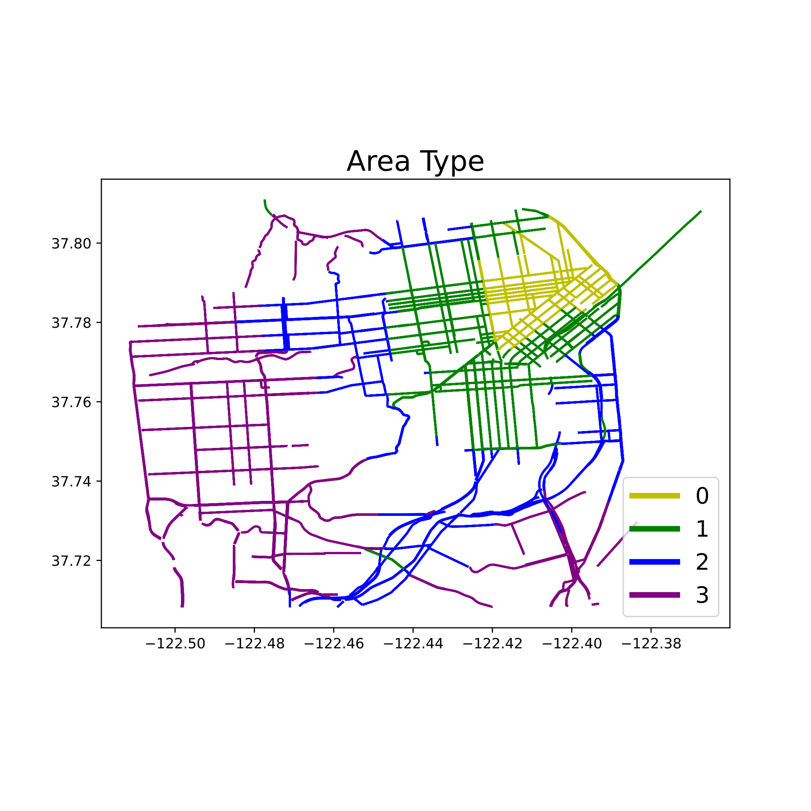
Area type
0 - Regional Core
1 - Central Business
2 - Urban Business
3 - Urban
Lower Area Types are closer to the city center which is why it is inversely correlated with TNC Flow

Slide 17
takeaways
Time and location are significant in understanding TNC Flow – those two variables alone explain 50% of the variance in our target
Increased bus frequency during the afternoon and evening would accommodate the amplified rush of travelers
Improved public transportation service would benefit local government, residents, and employees in the city

Slide 18
Future work
Expand model to evaluate more irregular conditions: weather, large scale events, holidays
Implement variables to account for transit only lanes and rush hour routes
Leverage and compare data on MUNI bus routes

Slide 19
Thank you!

Slide 20
APPENDIX

Slide 21
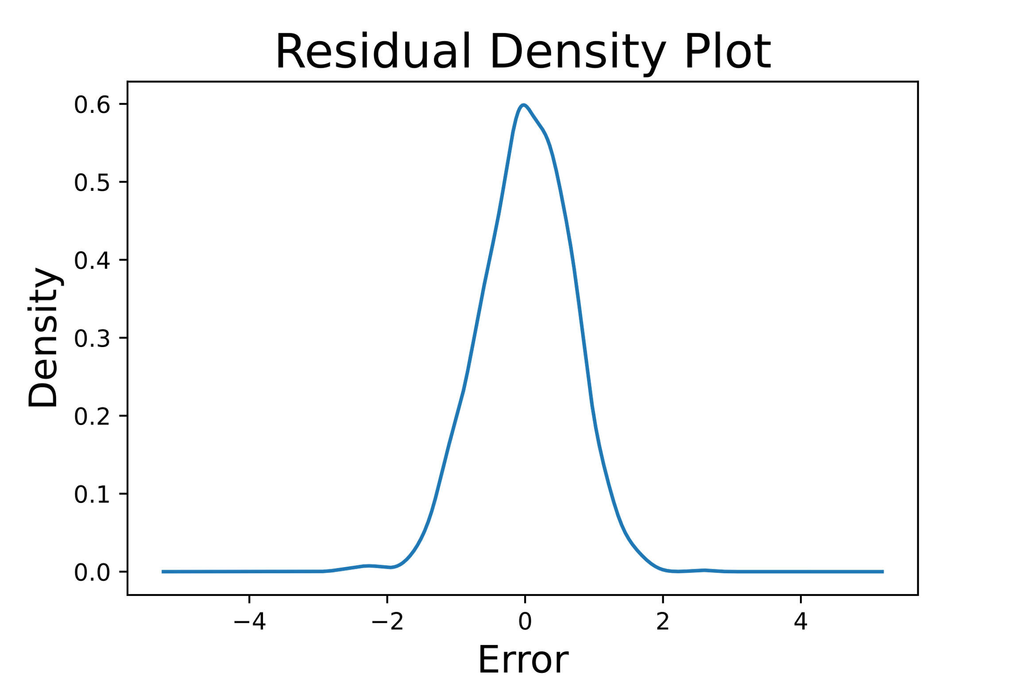
Residual density

Slide 22
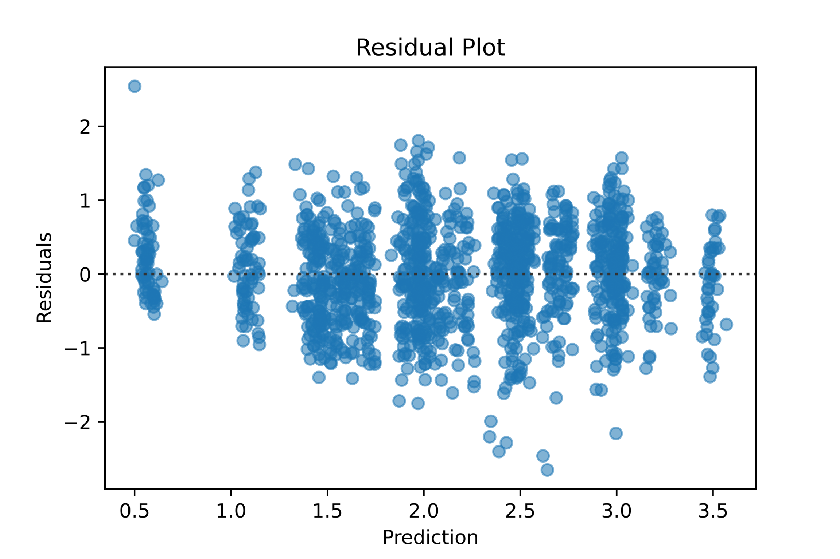
residuals

